Slide 1
A two hour Introduction of Reinforcement Learning
Cheng Li@Sensetime

Slide 2
outline
MDP & Reinforcement Learning
Algorithms
MCMC
TD-lambda
Q-learning
Actor-Critic
3 Papers

Slide 3
MDP
Many Problems Can be formulized As a MDP
Maze
Go
Blackjack(twenty-one)
Selection
Tracking
Clustering
…..

Slide 4
Necessary Elements in a MDP
State
Action
Transition
Reward

Slide 5
State
State
Action
Transition
Reward
State ---- Markovian
Full/Partially Observed

Slide 6
Action
State
Action
Transition
Reward
Action Space
Can be dynamic

Slide 7

Transition
State
Action
Transition
Reward
Discrete $T:S ×A→S$
Probability $T:S ×A→P(S)$
Transition can be seems as an operator

Slide 8

reward
State
Action
Transition
Reward
One step reward $R:S × A→ℜ$
Reward function has the same format as Q-function

Slide 9

Value function
State
Action
Transition
Reward
Value
Evaluate State( Given Policy)
V$:S→ℜ$
Discounted Accumulation of Reward (with ratio $γ$)

Slide 10

Q-function
State
Action
Transition
Reward
Value
Q-function
Long Term Reward
Q$:S × A→ℜ$
$Q\left(s,a\right)=R\left( s, a \right)+γ V( s^{′} )$

Slide 11

Policy
State
Action
Transition
Reward
Value
Q-function
Policy
Map State to Action
$$π:S→A$$
$A Common$Policy
$$π(s)={\text{argmax}}_{a}Q(s,a)$$

Slide 12
Elements in a MDP
State
Action
Transition
Reward
Value
Q-function
Policy

Slide 13
CONFUSE?

Slide 14
CONFUSE?
Some Examples:
Maze
Go
Blackjack(twenty-one)

Slide 15
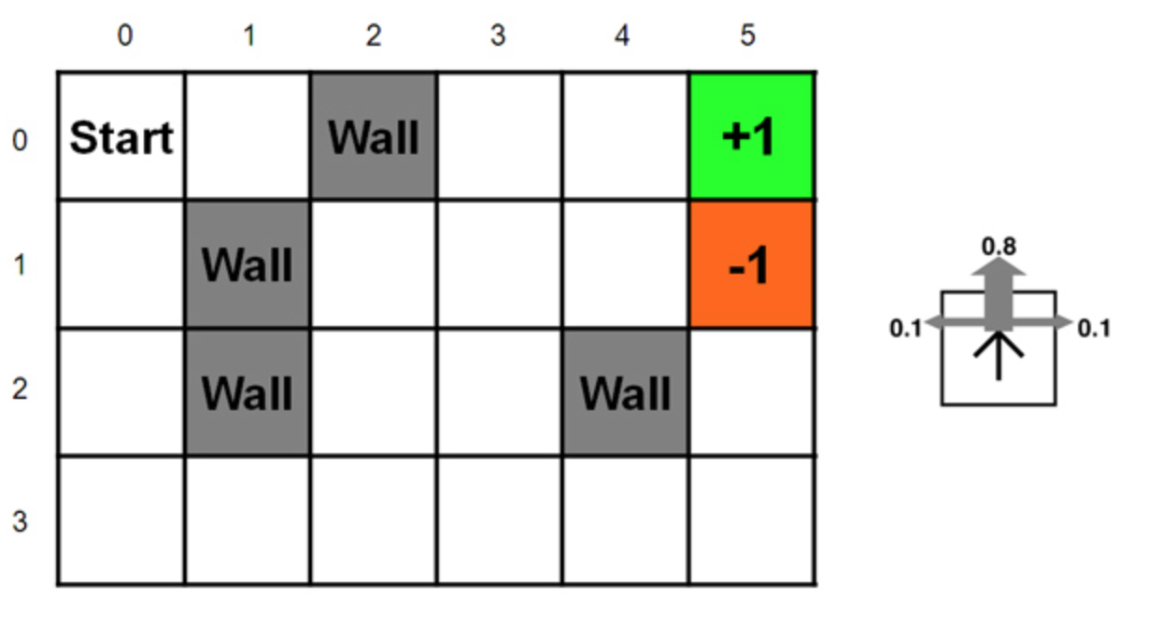
Maze: foolproof problem in rl
State
Action
Transition
Reward

Slide 16
State
State
Action
Transition
Reward
Position

Slide 17
ACTION
State
Action
Transition
Reward
4 Directions

Slide 18
Transition
State
Action
Transition
Reward
Direction → 80% successfully Executed

Slide 19
REWARD
State
Action
Transition
Reward
Reward: -0.04 for non-terminal

Slide 20
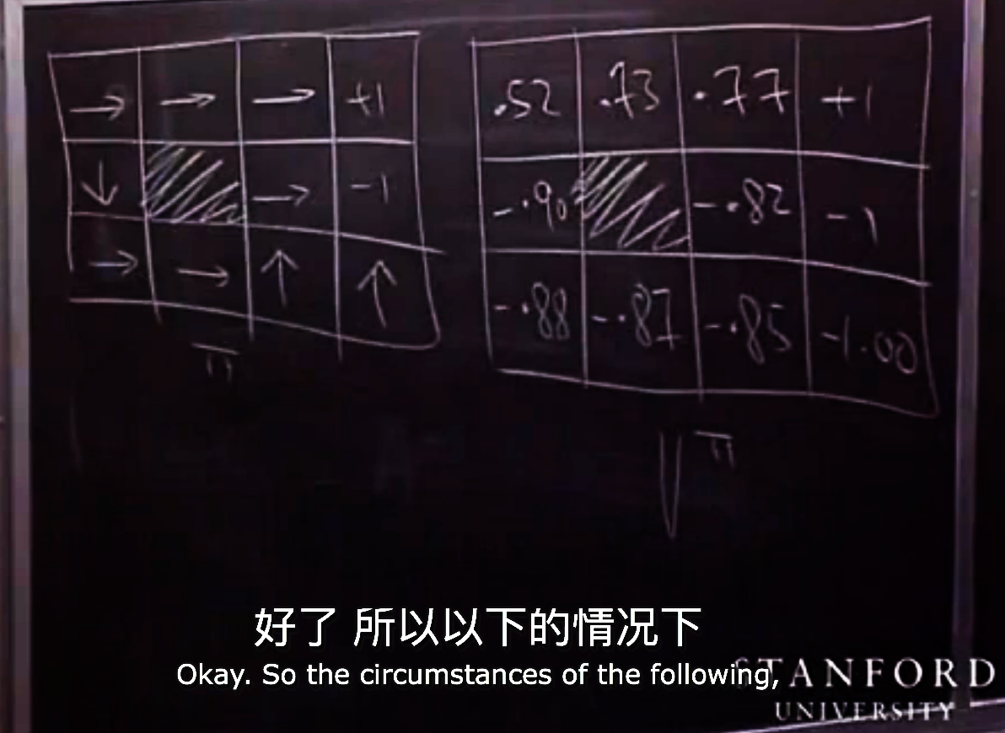
Value
State
Action
Transition
Reward
Value

Slide 21
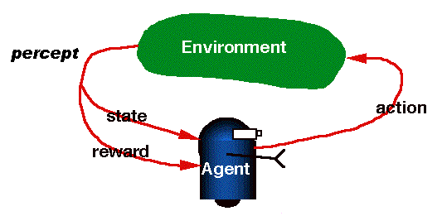
RL is from interaction

Slide 22
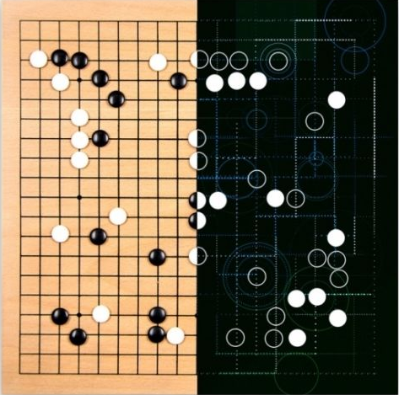
Go Game
State
Action
Transition
Reward

Slide 23

State
State
Action
Transition
Reward
Around $3^{361} States$
Difficult to Learn? → We have CNN

Slide 24
Go Game
State
Action
Transition
Reward
|A| = 381

Slide 25
Transition
State
Action
Transition
Reward
Deterministic → Why we can search

Slide 26
Reward
State
Action
Transition
Reward
How much area you occupied
Reward for non-terminal is not a big deal.

Slide 27
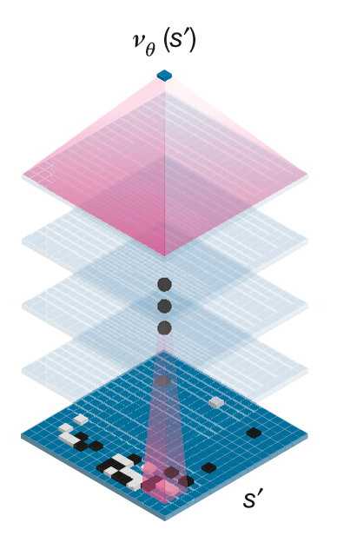
Value function
State
Action
Transition
Reward
Value
The biggest boost compare to the algorithm 5 years ago

Slide 28
Why searching?
State
Action
Transition
Reward
Value
Searching handles more detail case
Searching Provides a better estimation on value

Slide 29
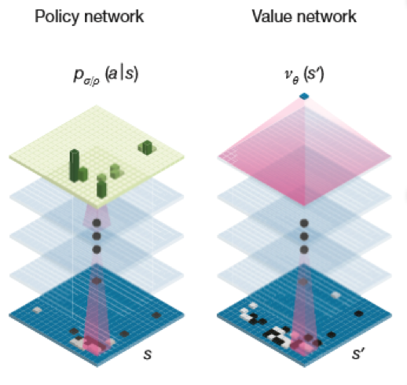
Policy
State
Action
Transition
Reward
Value
Policy
A Combine of
Actor-Critic
Q-Learning

Slide 30
If we solve maze&go, did we solve all plbm.?
Real World Problem are
Partially Observed
Continuous Problem

Slide 31
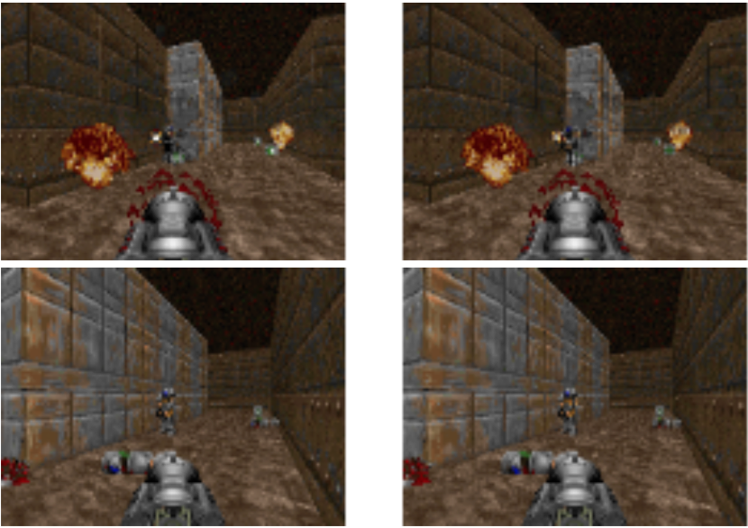

If we solve maze&go, did we solve all plbm.?
Real World Problem are
Partially Observed
Continuous Problem
Difficult to Simulate

Slide 32
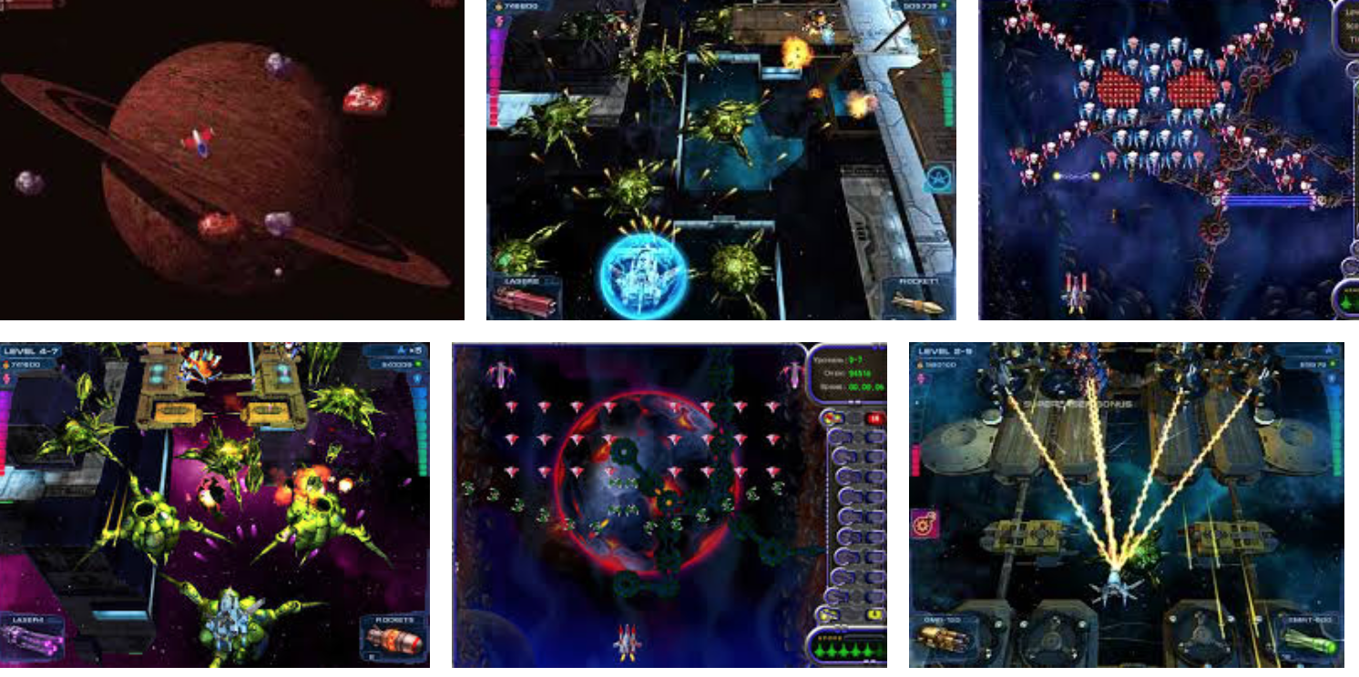
Example of partially observe
ASTRO Game
Blackjack( twenty-one )

Slide 33
Summary of mdp
State
Action
Transition
Reward
Value
Q-function
Policy

Slide 34
SHIFT to algorithms

Slide 35
Algorithms
Monto Carlo
Temporal-Difference
TD(0)
Q-Learning
Actor-Critic

Slide 36

Monte Carlo
Key Idea: Learn $V^{π}(s)$
How? Monte Carlo Sampling

Slide 37
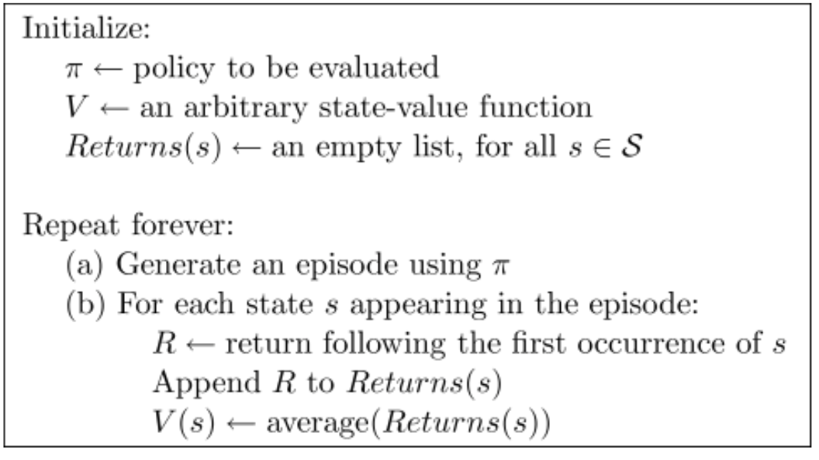
Monte Carlo
Key Idea: Learn $V^{π}(s)$
How? Monte Carlo Sampling

Slide 38
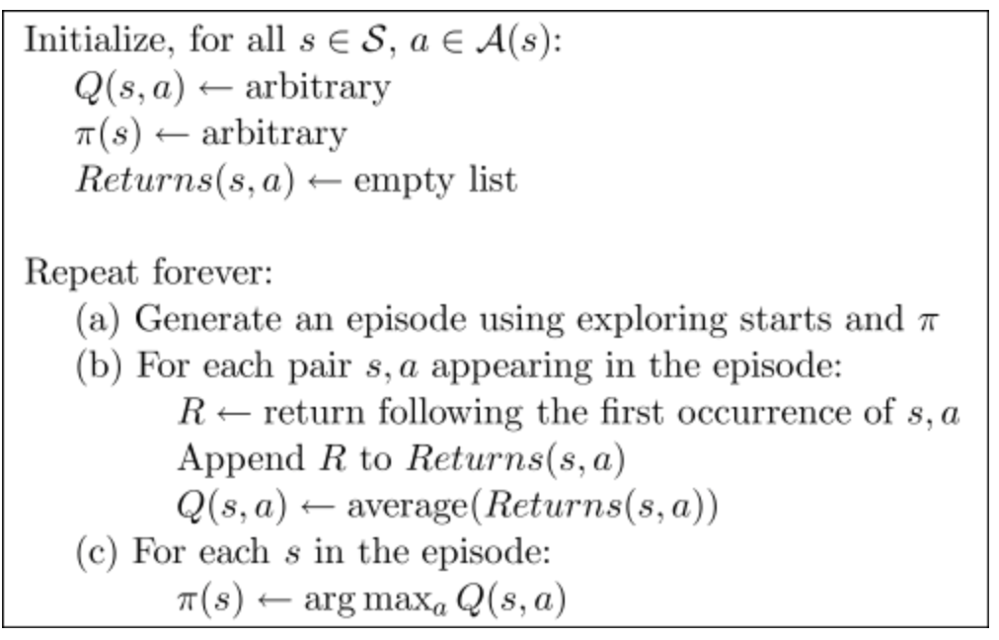
MC: Use Value to update policy

Slide 39
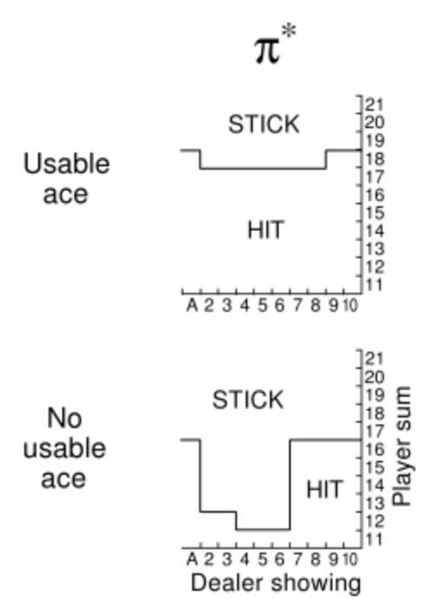
MC: Use Value to update policy
TODO：
查一下21点规则

Slide 40
TD(0)
Drawback of MC: Needs V → compute at the end
Wait until a terminal state
Some game even don’t have a terminal state

Slide 41
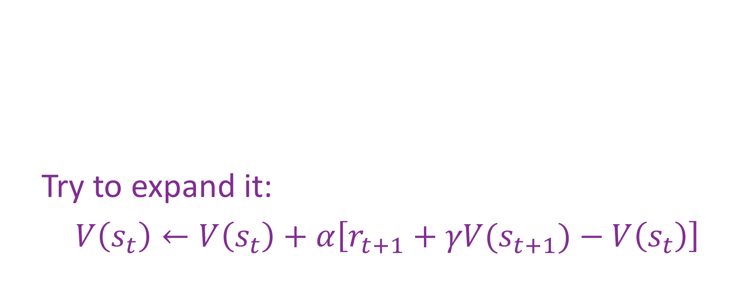
TD(0)( Key Idea )
Update in MC:
$V\left(s_{t}\right)←V\left(s_{t}\right)+α\left[R_{t}−V\left(s_{t}\right)\right]$
Try to expand it:
$V\left(s_{t}\right)←V\left(s_{t}\right)+α\left[r_{t+1}+γV(s_{t+1})−V\left(s_{t}\right)\right]$

Slide 42

td(0)( Key Idea )
Update in MC:
$V\left(s_{t}\right)←V\left(s_{t}\right)+α\left[R_{t}−V\left(s_{t}\right)\right]$
Try to expand it:
$V\left(s_{t}\right)←V\left(s_{t}\right)+α\left[r_{t+1}+γV(s_{t+1})−V\left(s_{t}\right)\right]$

Slide 43

td(0)( Key Idea )
$V\left(s_{t}\right)←V\left(s_{t}\right)+α\left[r_{t+1}+γV(s_{t+1})−V\left(s_{t}\right)\right]$
Something We Are Estimating on the fly

Slide 44
td(0)( Key Idea )
$V\left(s_{t}\right)←V\left(s_{t}\right)+α\left[r_{t+1}+γV(s_{t+1})−V\left(s_{t}\right)\right]$
Something We Are Estimating on the fly
Reward We set for the Game

Slide 45
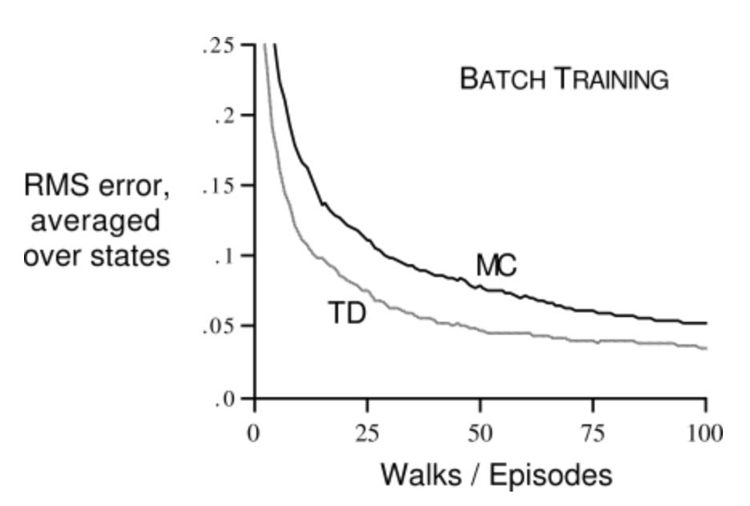
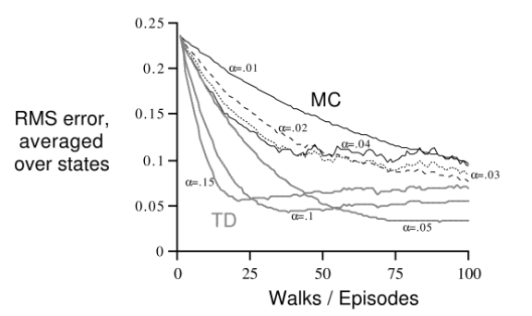
Advantage of td(0)

Slide 46

Q-Learning
$Q\left(s_{t},a_{t}\right)→Q\left(s_{t},a_{t}\right)+α[r_{t+1}+γ\max_{a}{Q\left(s_{t+1},a_{t}\right)−Q\left(s_{t},a_{t}\right)}]$

Slide 47

Q-Learning
$Q\left(s_{t},a_{t}\right)→Q\left(s_{t},a_{t}\right)+α[r_{t+1}+γ\max_{a}{Q\left(s_{t+1},a_{t}\right)−Q\left(s_{t},a_{t}\right)}]$
Original Q-Learning were purposed as Off-Policy

Slide 48
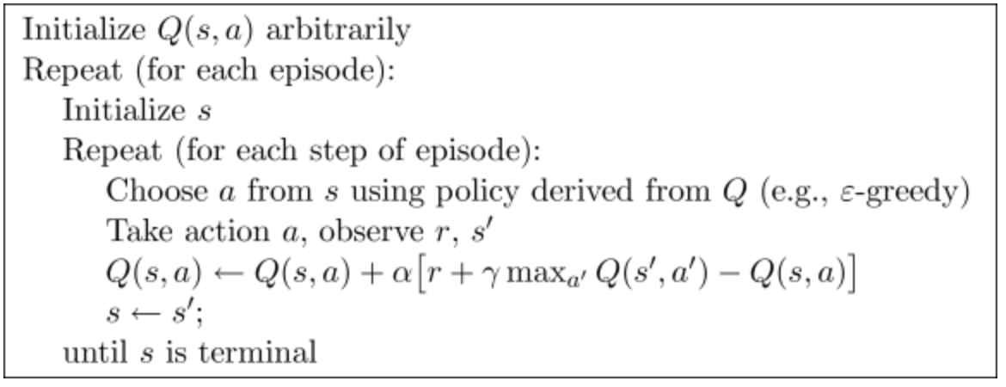
Q-Learning
$Q\left(s_{t},a_{t}\right)→Q\left(s_{t},a_{t}\right)+α[r_{t+1}+γ\max_{a}{Q\left(s_{t+1},a_{t}\right)−Q\left(s_{t},a_{t}\right)}]$
Original Q-Learning were purposed as Off-Policy

Slide 49
Why is q-learning considered off-policy

Slide 50
Actor-Critic Methods
Directly Learn Policy
Earliest RL systems
More attention has been devoted to learn action-value function
The divergence may be historical accident
Advantages
Minimal Computation in order to select action
Can learn a stochastic policy

Slide 51
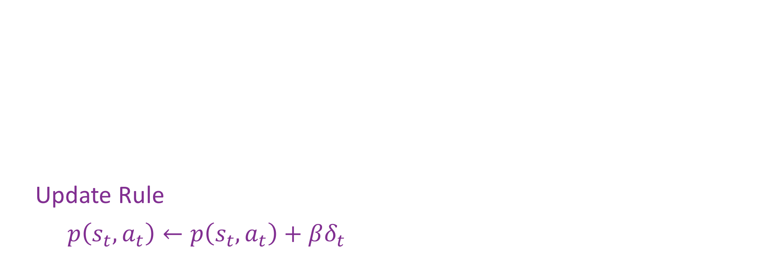
Actor-Critic Methods
TD Error
$δ_{t}=r_{t+1}+γV\left(s_{t+1}\right)−V\left(s_{t}\right)$
Action are generated by Gibbs
$π_{t}\left(s,a\right)= \frac{e^{p(s,a)}}{\sum_{b}{e^{p(s,b)}}}$
Update Rule
$p\left(s_{t},a_{t}\right)←p\left(s_{t},a_{t}\right)+βδ_{t}$

Slide 52

Actor-Critic Methods
TD Error
$δ_{t}=r_{t+1}+γV\left(s_{t+1}\right)−V\left(s_{t}\right)$
Action are generated by Gibbs
$π_{t}\left(s,a\right)= \frac{e^{p(s,a)}}{\sum_{b}{e^{p(s,b)}}}$
Update Rule
$p\left(s_{t},a_{t}\right)←p\left(s_{t},a_{t}\right)+βδ_{t}$

Slide 53
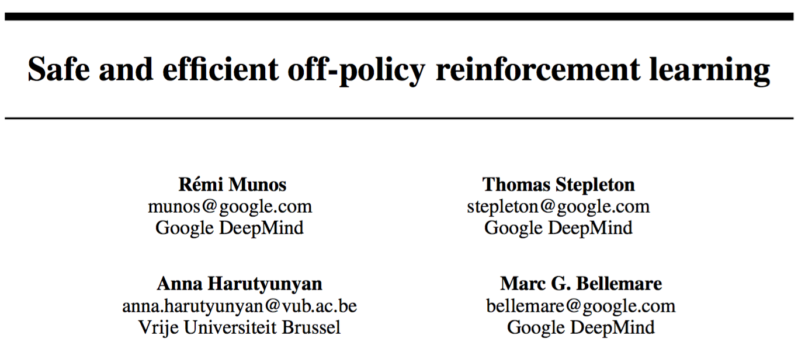

Slide 54
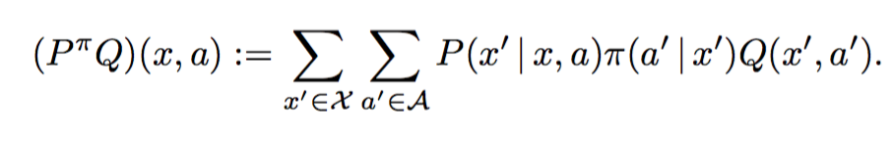
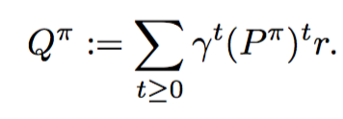
A function understanding on q-learning
Transition as an Operator

Slide 55
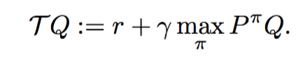
Bell optimality operator

Slide 56
Off-policy algorithm
Use C to balance visit frequency between observed policy mu and optimal policy pi

Slide 57
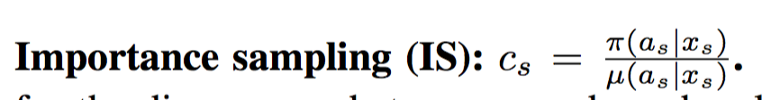
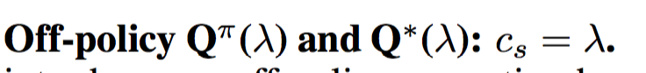
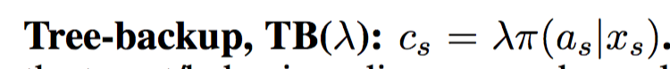
Off-policy algorithm

Slide 58
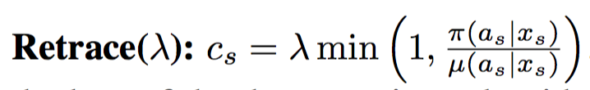
Off-policy algorithm
Purposed::

Slide 59
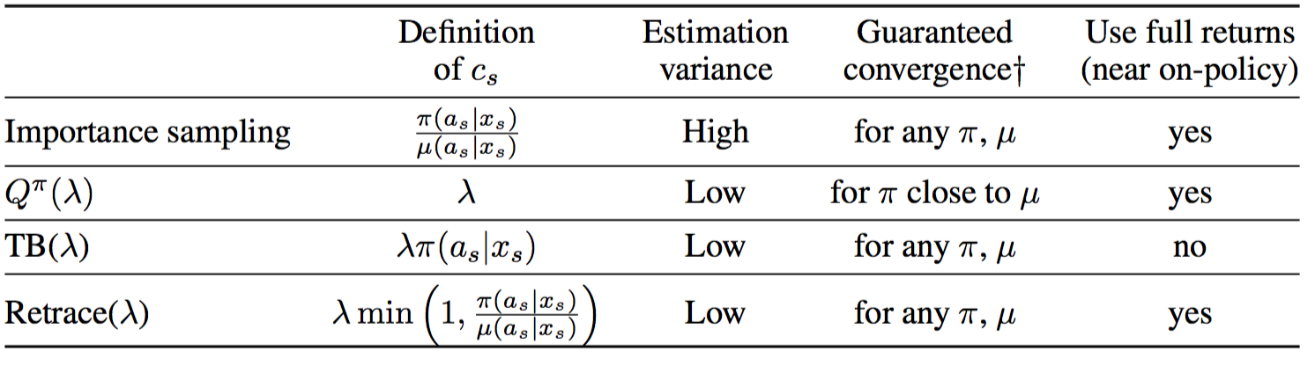
Off-policy algorithm
Purposed::

Slide 60
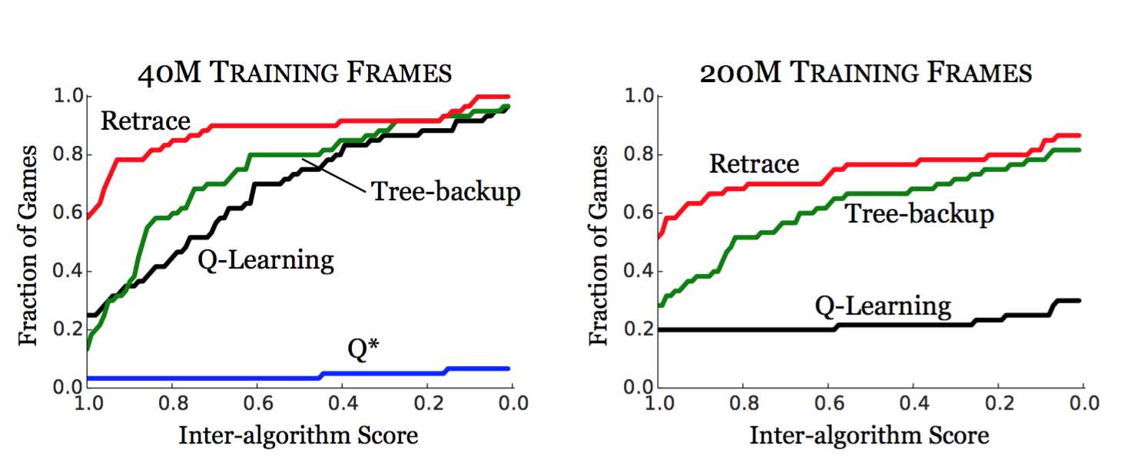
Experiment(60 Atari games)

Slide 61
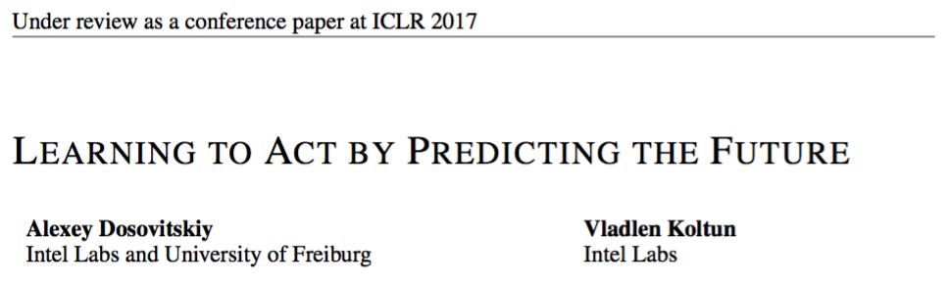
A variation of mc
Winner of full Deathmatch track of Doom Competition

Slide 62
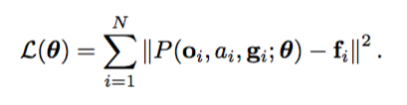
Supervise learning?
They call it Supervise Learning, learns Predictor

Slide 63
Measurement
Difference of future and present measurements

Slide 64
Measurement
Difference of future and present measurements
Measurement
Attitude
Supply levles
Structural integrity
Health
Ammunition
socre

Slide 65
Measurement
Difference of future and present measurements
Temporal offsets

Slide 66
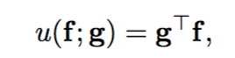
Goal?

Slide 67
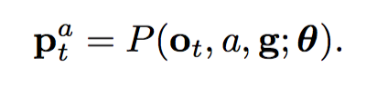
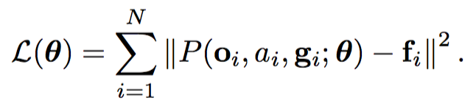
Goal?
Predictor

Slide 68
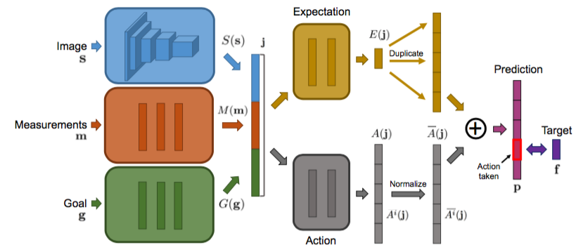
Predictor

Slide 69
Policy
Goal?
Predictor

Slide 70
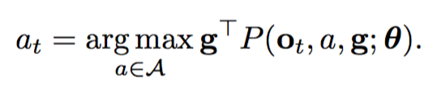
Policy
Goal?
Predictor

Slide 71
evaluation
Single Goal
Randomized Goals
Randomly sampled from a set

Slide 72
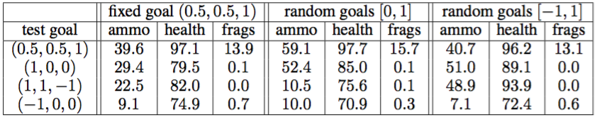
evaluation
Single Goal
Randomized Goals
Randomly sampled from a set

Slide 73
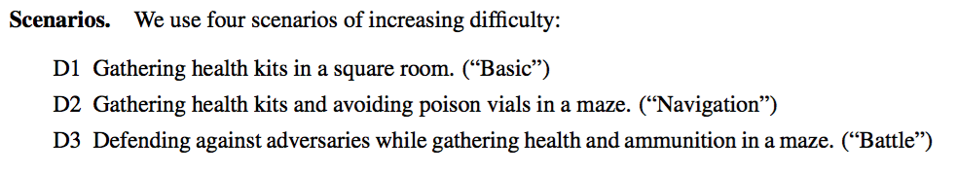
Scenarios

Slide 74
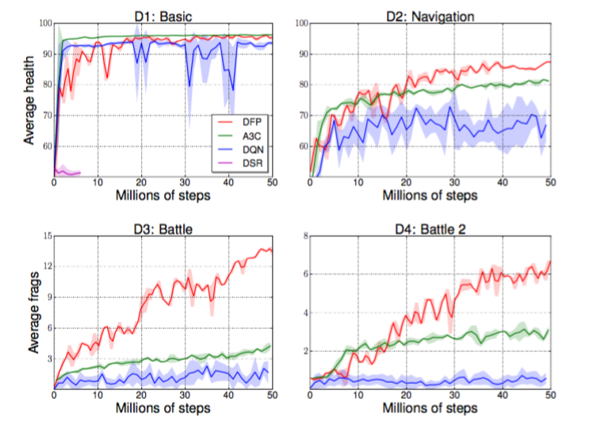
Scenarios

Slide 75
Discussion
Instead of Learn Value or Policy → Learn partially of future state
Future state can be seems as intergradient of value function
More supervise information
Tricky part is treat action and g vector as input
Multi-dimensional Version of MC but even better

Slide 76
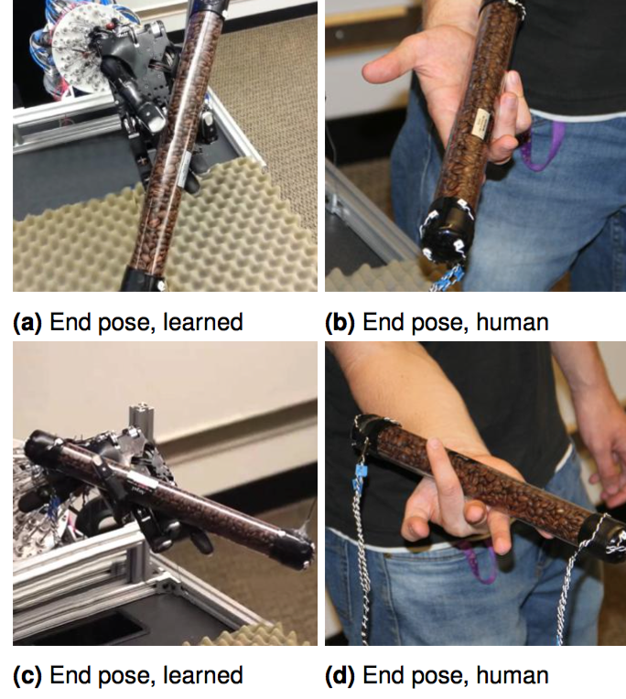
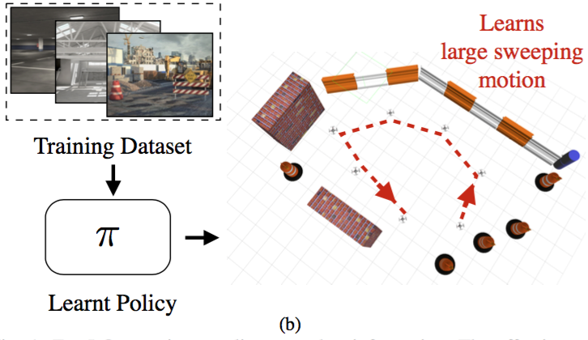
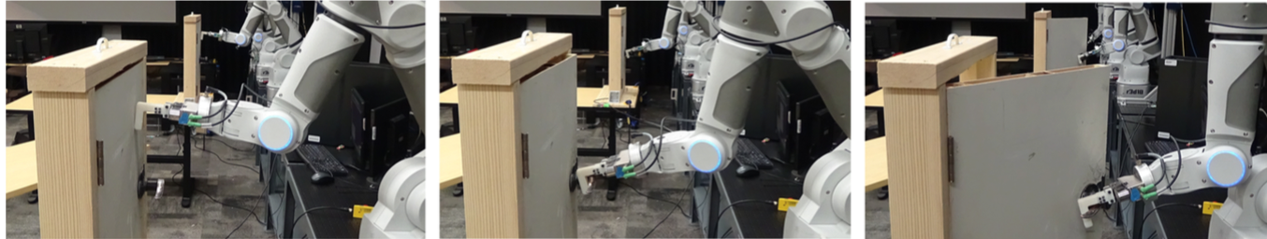
NEXT Episode
Robotic Application
Imitation Learning

